Slide 1
Reinforcement Learning
Actor-Critic, GAE, and PPO
Introduction to Deep Learning: Class 7.5

Slide 2
Module outline
Class | Title | Main output
1 | Bandits, MDPs, Returns | agent/environment/reward
2 | Value Functions and Bellman Equations | Learning to solve a reinforcement learning problems by iteratively estimating the value of a state
3 | Monte Carlo, TD, SARSA, Q-Learning | On-policy vs off-policy, sampled experience
4 | Policy Gradients and REINFORCE | log-prob weighted by reward
5 | Actor-Critic and PPO | advantage, critic, clipping
6 | RLHF and GRPO | PPO/GRPO to LLM training

Slide 3
Agenda and references
GRPO and its variants

Slide 4
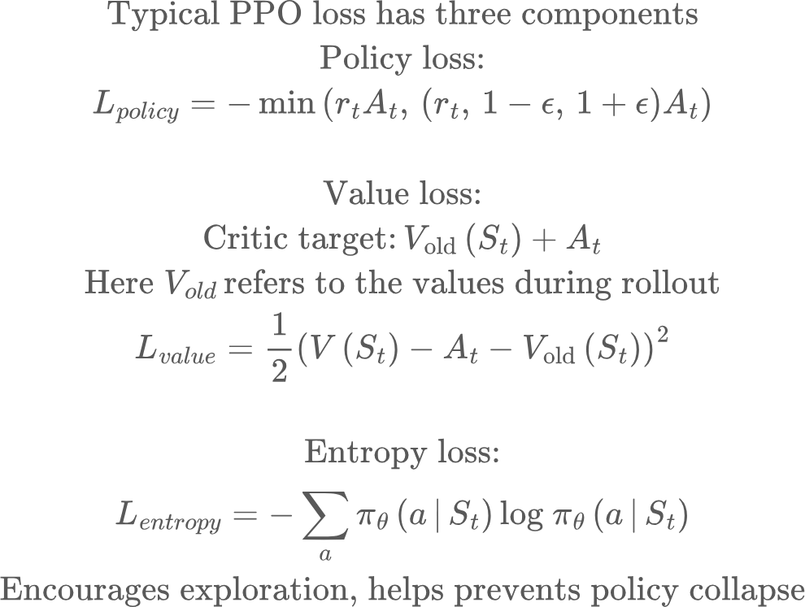
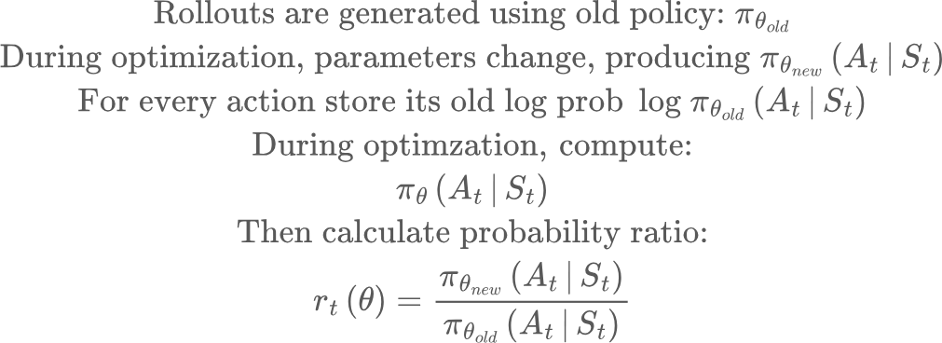
PPO: Proximal Policy Optimization

Slide 5
Difficulty applying PPO to LLMs
Unlike Cartpole, in a LLM, we generally get a reward signal in the end, once generation has completed, rather than for every token. This makes value function training unstable, due to the credit assignment problem
Recall:
State
Action
Policy
Reward

Slide 6
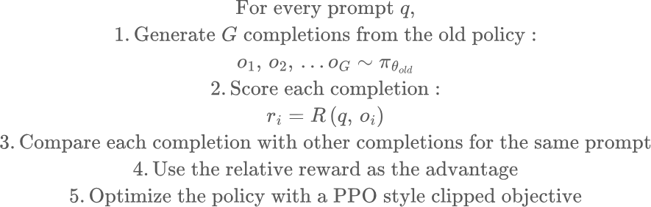
Group Relative Policy Optimization (GRPO)
Main idea: Generate multiple completions for a prompt, and use relative rewards as the advantage. No need for separate value estimation

Slide 7
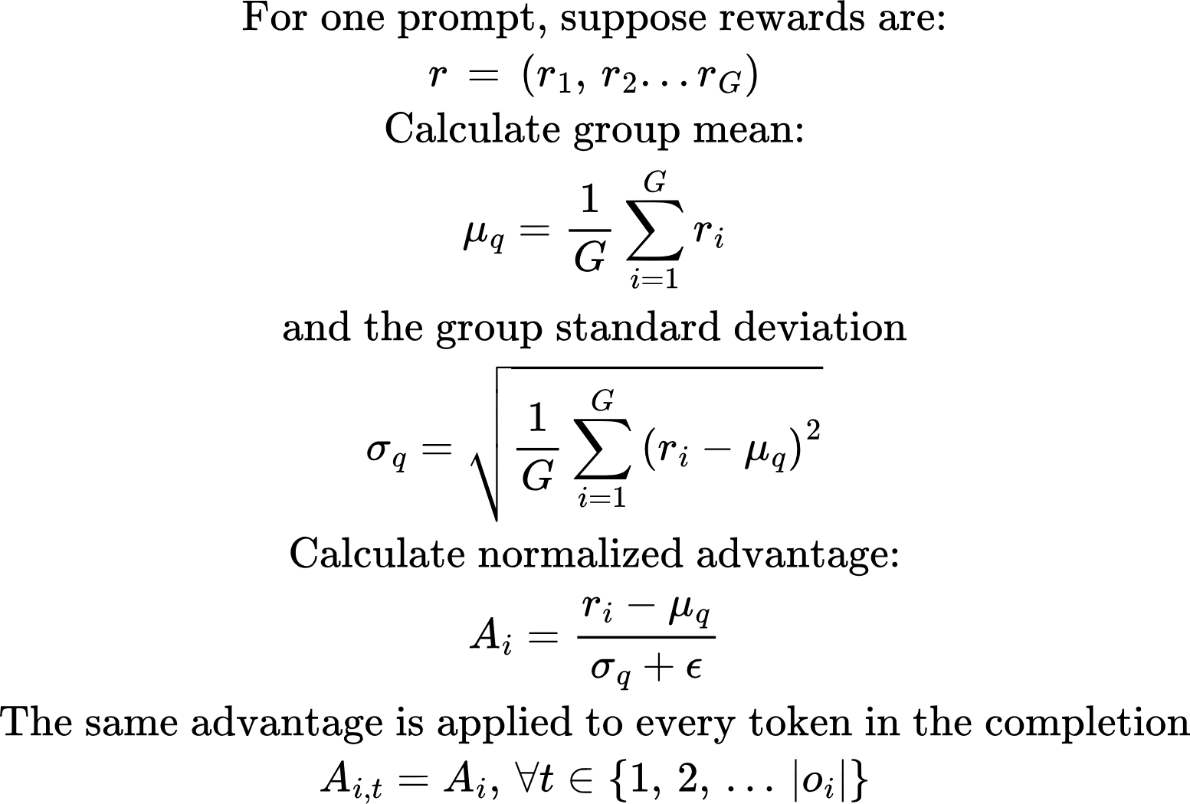
GRPO’s main idea

Slide 8
GRPO: Observations
The rewards are relative to the group. Harder prompt groups may have lower rewards..
The same reward is broadcast to all tokens in the completion. If response was better than average, all tokens are encouraged. If response was worse than average, all tokens are discouraged
We need diversity of responses for GRPO to work. If all rewards are the same, there is no learning signal

Slide 9
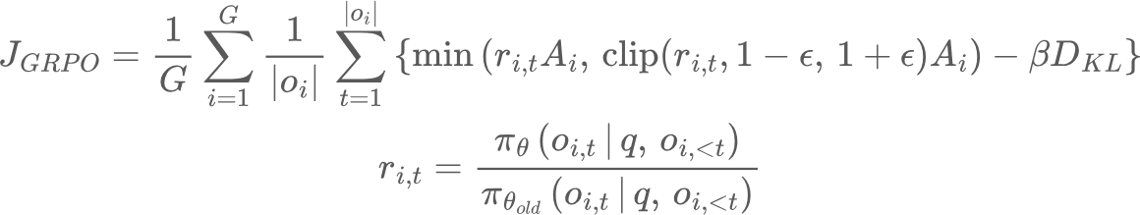
GRPO: Full objective
Average over completions
Average over tokens in a completion
policy bring optimized
policy used for generating completions
Importance sampling ratio
token t in completion i

Slide 10
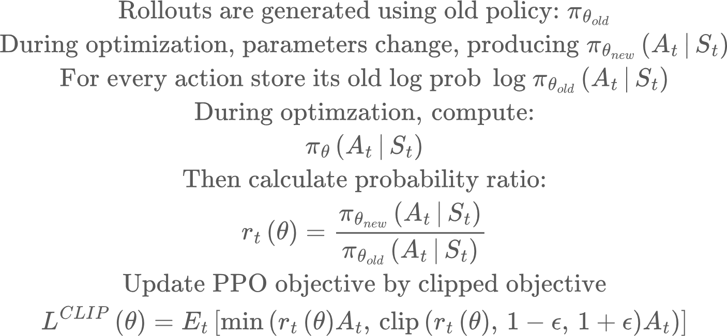
Clipping logic
Say At > 1, rt = 1.1, epsilon = 0.2. Then the action At is more likely under the new policy than the old policy, and the gradient update will make it even likelier. But if rt = 1.3, clipping happens, and we have L = 1.2*A_t, whose gradient wrt the policy parameters is zero

Slide 11
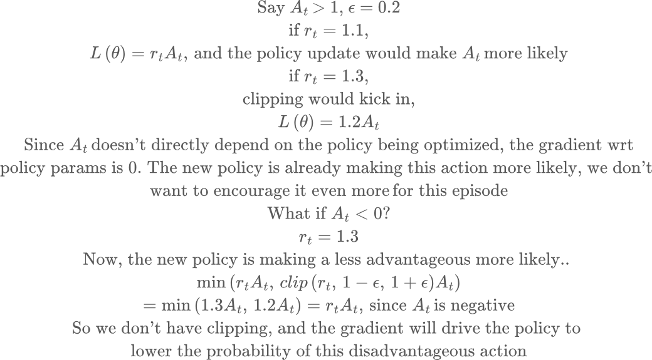
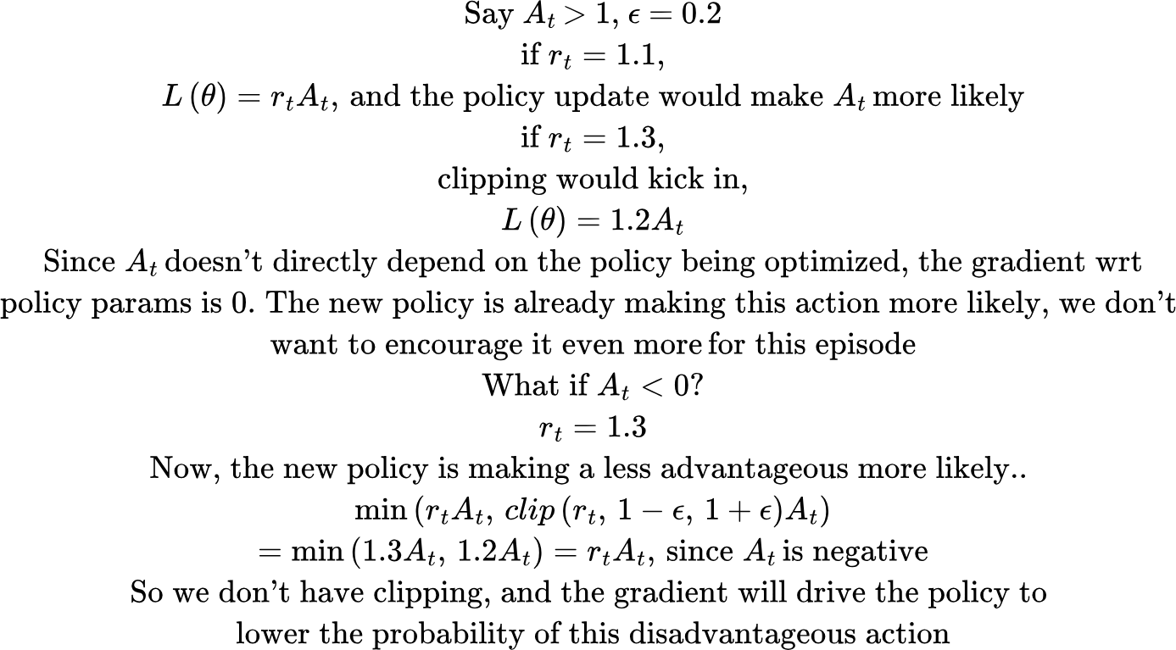
Clipping logic

Slide 12
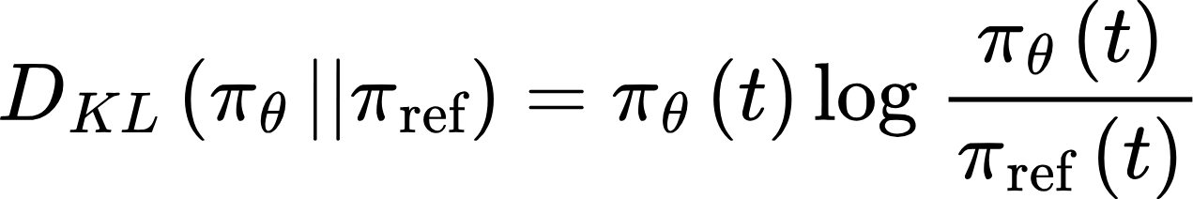



KL Regularization
Next token prediction
SFT
RL
Policy used to generate rollouts
Policy being trained

Slide 13
GRPO Algorithm: Recap
1. Sample a batch of prompts.
2. Snapshot the rollout policy π_old.
3. For every prompt, sample G completions.
4. Calculate rewards for all completions.
5. Normalize rewards within each prompt group.
7. Store old token log probabilities.
8. For one or more optimization passes:
recompute current token log probabilities form new/old ratios apply PPO clipping optionally add KL to reference policy update policy parameters
9. Set π_old = updated policy. Π_ref doesn’t change
10. Repeat with newly generated completions.

Slide 14
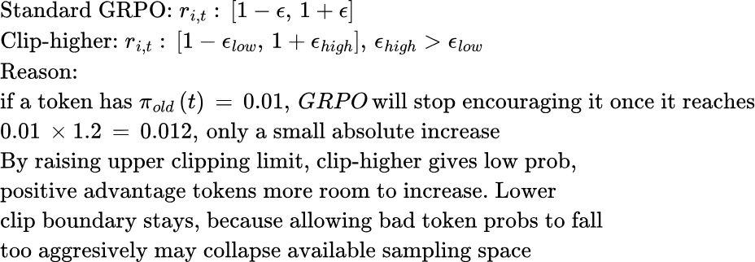
GRPO variants
Dividing by standard dev can amplify small reward differentials, remove division by standard deviation
G1 = [0, 0, 0, 0.01], G2 = [0, 0, 0, 1] will produce identical normalized advantage
Clip higher

Slide 15
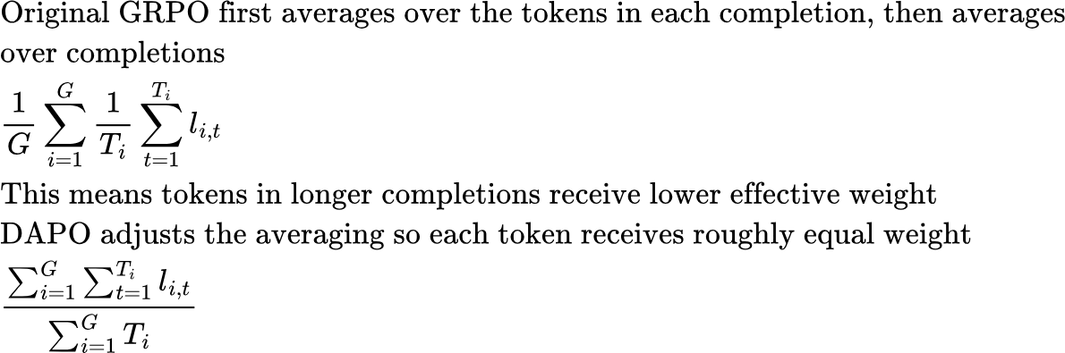
GRPO variants
Token level policy gradient loss

Slide 16
Course recap
Optimization, matrix math, derivatives
Neural networks, forward pass, backward pass, backprop
Monitoring, drift, explainability methods
Information retrieval--relevancy metrics, lexical vs semantic
Neural architectures and transformer systems
Reinforcement Learning
Inference engines

